Slide 1


Slide 2

Minicurso Bioinformática
Prof. Dr. Diego M. Riaño-Pachón

Slide 3
Minicurso Bioinformática
Part I - Intro to bioinformatics, main databases and sequence similarity
Part II – Bioinformatics tools for the identification of Microorganisms using sequence data
Part III – Bioinformatics applied to genomics

Slide 4
Part I
Introduction to Bioinformatics
Prof. Dr. Diego Mauricio Riaño-Pachón
Laboratório de Biologia Computacional, Evolutiva e de Sistemas
Centro de Energia Nuclear na Agricultura
Universidade de São Paulo
Piracicaba, Brasil
diego.riano@cena.usp.br

Slide 5
Talk a Little bit about youselves
Who are you?
Why are you interested in this course?

Slide 6
The plan for the next two days
What’s Bioinformatics?
Databases in Biology: Focus on some NCBI DBs and tools
Sequence comparison (BLAST, species identification)
The basics of genome sequencing and assembly

Slide 7

Flow of information in the cell

Slide 8
What is Bioinformatics?
Computer science
Biology
Today in biological/biomedical sciences we work with full sets of different “things” => OMICS
Bioinf
Mathematics & Statistics
The use of computational, mathematical and statistical tools/concepts, for generating, handling, analyzing and interpreting biological data
Notes:
La bioinformática es una disciplina que surge de la interacción entre la biología, la estadística y las ciencias de la computación (Figura 1.1. Tiene como principales objetivos el manejo y análisis de grandes volúmenes de datos, principalmente producto de las nuevas tecnologías en biología molecular, como la genómica, la proteómica y la metabolómica, especialmente hoy en día con el advenimiento de nuevas tecnologías de secuenciación de ácidos nucleicos que están revolucionando la forma en como estudiamos los genomas. Otro aspecto importante incluye el desarrollo de nuevos métodos computacionales, algoritmos y/o software, para el análisis de esos datos. Según Philip Bourne (UCSD), “la bioinformática se ha convertido en el interprete del lenguaje genómico del ADN y está intentando descifrar lenguajes mas complejos en los que las proteínas son los sustantivos, las interacciones son la sintaxis, las rutas metabólicas son las oraciones y los sistemas vivos son el volumen completo” (Bourne, 2004).Por lo tanto, de forma similar a la biología molecular, la bioinformática constituye hoy en día una caja de herramientas que todo investigador en biología tiene que manejar (Stein, 2008 presenta un punto de vista muy interesante).

Slide 9
Databases in Biology: NCBI Entrez and some of its tools

Slide 10

Created on Nov 4th, 1998, as a division of NLM and NIH
What it does:
Research at the molecular level in biomedical sciences, employing mathematical and computational methods.
Collaboration with other institutes from the NIH, with academy, industry and other agencies
Science communication, through meetings, workshops and conferences.
Training in basic and applied research in computational biology.
Develops, distributes, supports and coordinates access to many databases, and software for the scientific and medical community.
Develops and promotes standards for data interchange.
http://www.ncbi.nlm.nih.gov/About/glance/ourmission.html

Slide 11
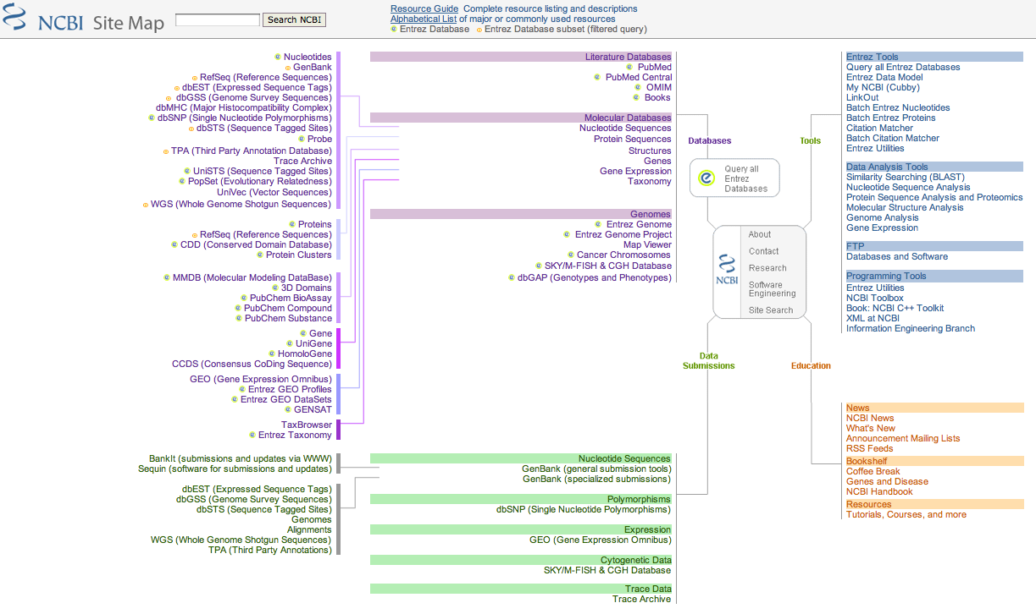
NCBI: Site map
Manual NCBI: http://www.ncbi.nlm.nih.gov/bookshelf/br.fcgi?book=handbook
http://www.ncbi.nlm.nih.gov/Sitemap

Slide 12
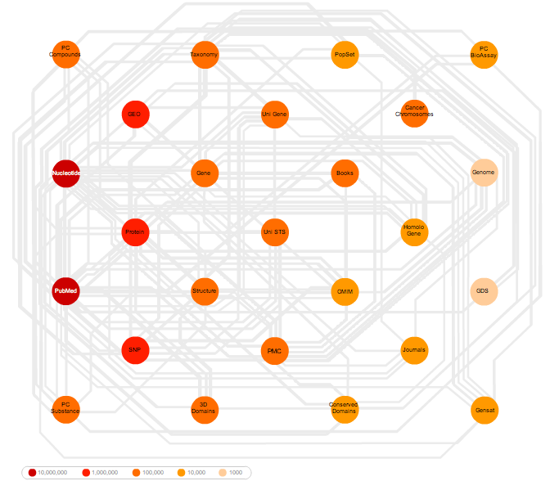
NCBI: Entrez The life science search engine
Not a database itself, but a interface to query several databases at once:
Literature
Sequences
ADN
Proteins
3D structures
Protein domains
Population studies
Gene expression data
Genome data
Taxonomic information
Databases are crossreferenced!
http://www.ncbi.nlm.nih.gov/Entrez/

Slide 13
Entrez: neighbors
Besides running the search simultaneously in all databases and create links among the different databases, ENTREZ implements the concept of neighbor entries in the same databases, e.g., related sequences, related 3D structures.
Online exercise (Hint: use the option for advanced search)
Go to http://www.ncbi.nlm.nih.gov/
Search for Hemoglobin Subunit Beta (HBB) mRNA in humans
Select nucleotide from the result screen
Show the entry NM_000518.4
Identify the different pieces of information from the results screen.

Slide 14
Entrez: Programmatic access
API: Application program interface
Eutils: Access to the data in ENTREZ, with out using the web interface. Very useful to automatically retrieve data.
http://www.ncbi.nlm.nih.gov/entrez/query/static/eutils_help.html

Slide 15
Some of the databases at NCBI

Slide 16
GenBank
Nucleotide sequence database
Part of the “International Nucleotide Sequence Database Collaboration”, that is integrated in addition by EMBL y el DDBJ
In their latest release (15th April. 2016) there are 211.423.912.047 bases, from 193.739.511 reported sequences.
It is updated approx. every 2 months
Sequences are directly submitted by their own authors. There is a minimal quality check carried out by GenBank staff, and all the information associated to a sequence depends completely on their submitters
The level of redundancy is high
http://www.ncbi.nlm.nih.gov/genbank/
Notes:
La anotación de una secuencia consiste en
la identificación de regiones en la estructura primaria, e.g., intrones, exones, dominios, motivos.
Asignar papeles biológicos a la secuencia, e.g., tejidos en donde se expresa, procesos moleculares en los que participa.

Slide 17
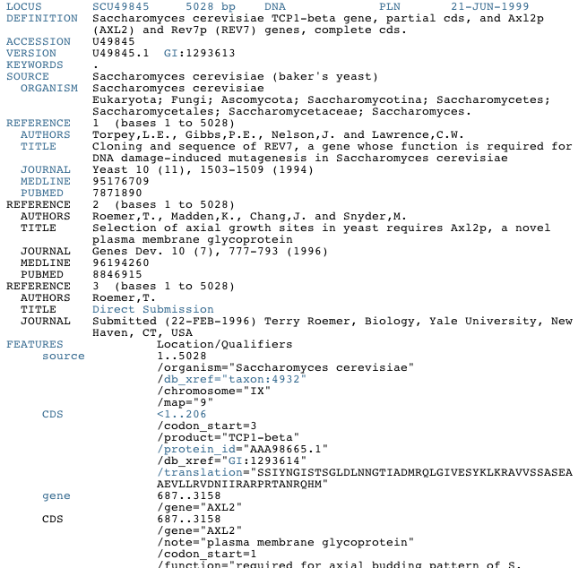
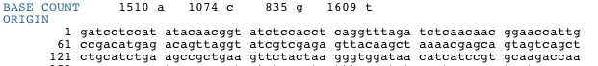
Record format for a GenBank entry
Answer the following:
What divisions does the GenBank have? What do they represent?
http://www.ncbi.nlm.nih.gov/Sitemap/samplerecord.html

Slide 18
Identifiers in the GenBank format
Locus name: Up to 10 characters, must be unique. Due to the increase in the number of sequences in the last decades, the 10 char limit is not enough anymore. It was the first identifier in use, and have among its goals give an idea about the function of the gene, and its source organisms, e.g. HUMBB: human β-globin region
Accession Number: Unique identifier. It is conserved (stable) across releases. Has the structure: 1+5 o 2+6. (Character + Numbers) The characters indicate the databases. This identifier never changes for a given entry in the database.
Version: This is combined to the Accession number, and indicates the version of the entry.

Slide 19
RefSeq
In contrast with genBank this is a curated database (secondary). It is curated by NBI staff and includes DNA, RNA and protein sequences.
Each molecule has a single entry in RefSeq, so there is not redundancy.

Slide 20
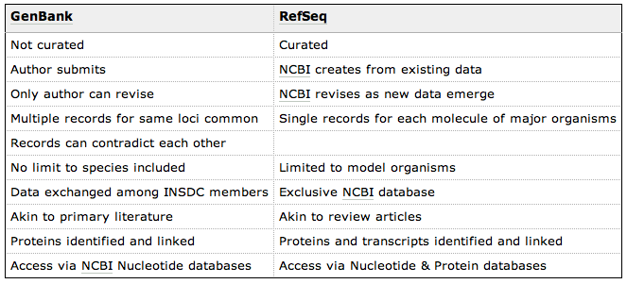
GenBank vs. RefSeq

Slide 21
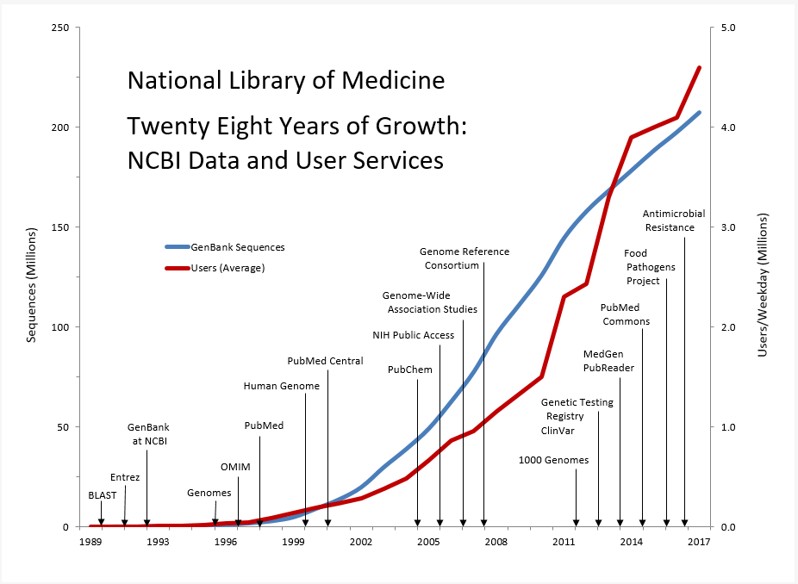
https://www.nlm.nih.gov/about/2019CJ.html

Slide 22
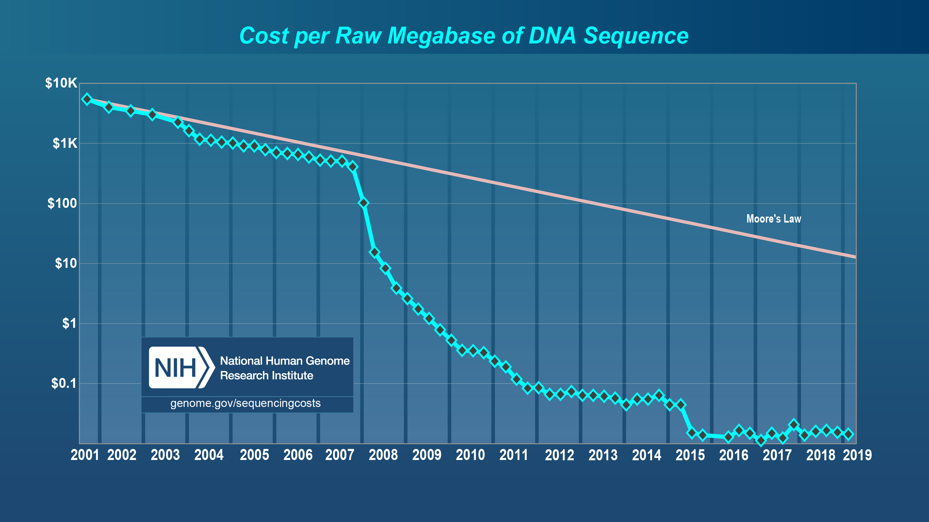

Slide 23
The data deluge: Costs
“in the not too distant future it will cost less to sequence a base of DNA than to store it on a hard disk”
Stein, 2010. Genome Biology, 11:207
There is not enough bioinformaticians to cope with the speed for data generation.
Biologist should become savy on their own sequence data analysis
Notes:
http://www.genomebiology.com/2010/11/5/207/figure/F2?highres=y
http://genomebiology.com/2010/11/5/207
Historical trends in storage prices versus DNA sequencing costs. The blue squares describe the historic cost of disk prices in megabytes per US dollar. The long-term trend (blue line, which is a straight line here because the plot is logarithmic) shows exponential growth in storage per dollar with a doubling time of roughly 1.5 years. The cost of DNA sequencing, expressed in base pairs per dollar, is shown by the red triangles. It follows an exponential curve (yellow line) with a doubling time slightly slower than disk storage until 2004, when next generation sequencing (NGS) causes an inflection in the curve to a doubling time of less than 6 months (red line). These curves are not corrected for inflation or for the 'fully loaded' cost of sequencing and disk storage, which would include personnel costs, depreciation and overhead.

Slide 24
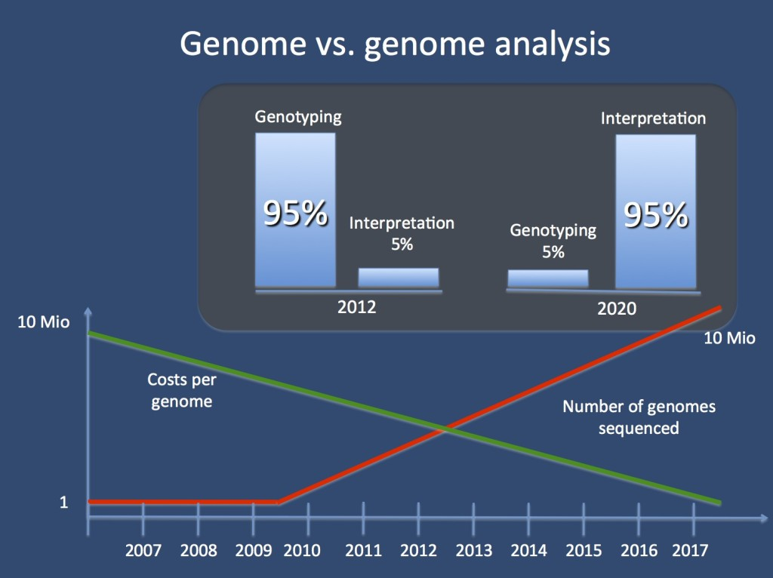
http://epilepsygenetics.net/2014/06/27/when-will-we-have-the-1000-epilepsy-genome/

Slide 25

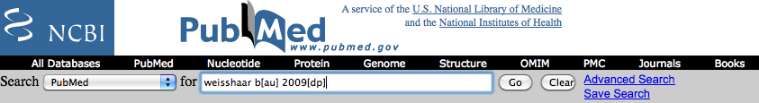
PubMed
http://www.pubmed.gov/

Slide 26
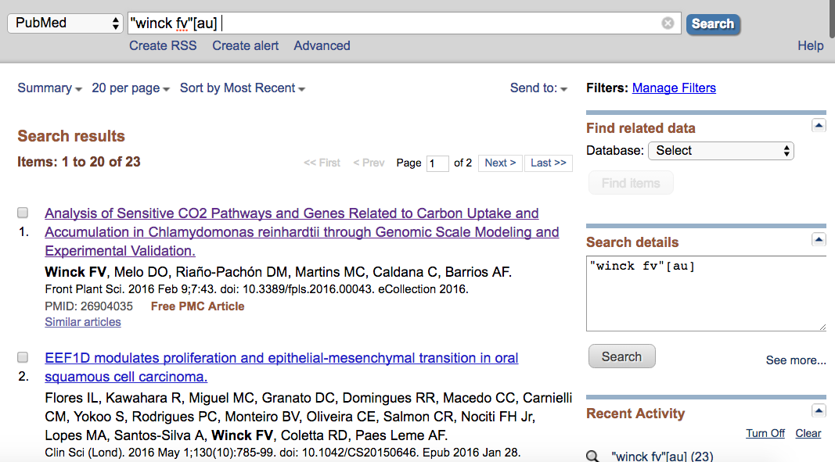
PubMed

Slide 27
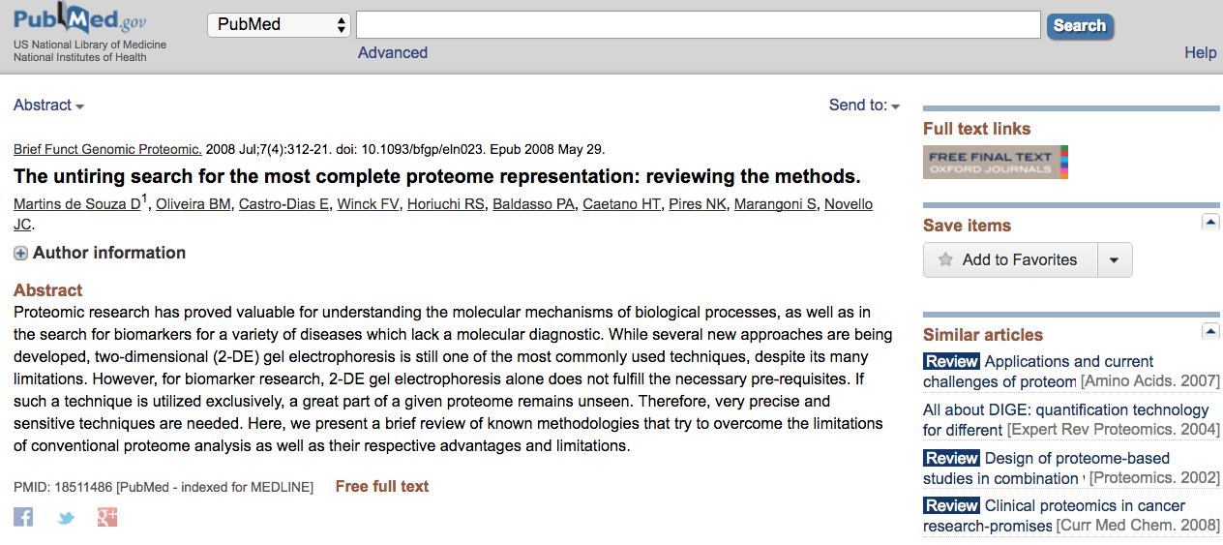
PubMed

Slide 28
Some other databases @ NCBI
OMIM: Online Mendelian Inheritance in Man. Catalogue of human genes and genetic disorders
Books: NCBI offers several dozens of book online
Taxonomy: Taxonomy search engine for the mayor taxonomy divisions.
Structure: Molecular Modelling Database. Contains 3D protein structures.

Slide 29

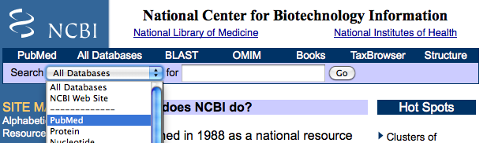
Entrez
Go to the site: http://www.ncbi.nlm.nih.gov/
Select the database: PubMed

Slide 30
Entrez
Search for the papers of a single author (Weisshaar B) from one specific year (2009). Use the modifiers DP y AU. As it is shown below:
http://www.ncbi.nlm.nih.gov/
As an alternative option you can use the “Advance search” option
http://www.ncbi.nlm.nih.gov/bookshelf/br.fcgi?book=helppubmed&part=pubmedhelp#pubmedhelp.Search_Field_Descrip

Slide 31
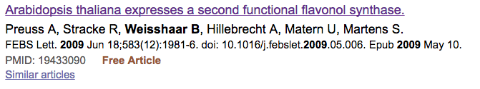
Entrez
Select the paper shown in the figure:
You can follow this link to find other papers on the same matter.
Click on the title of the paper.

Slide 32
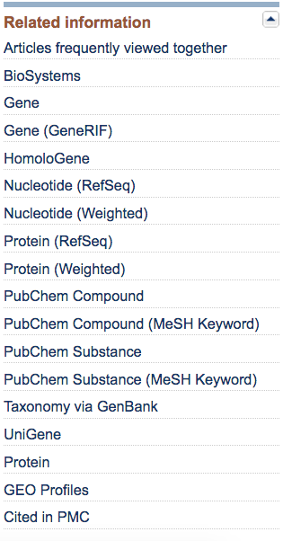
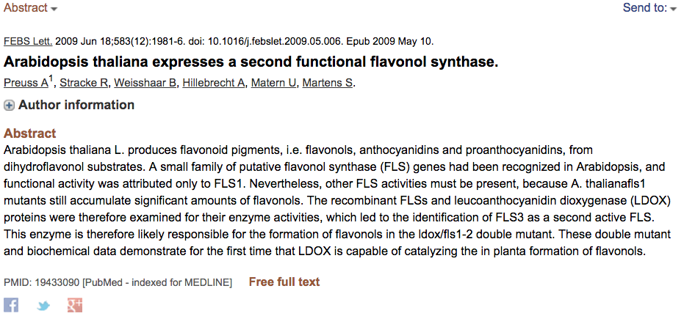
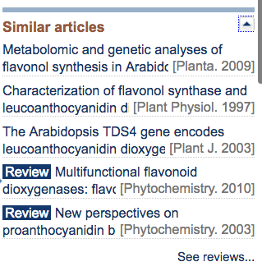
Entrez
Abstract
Look for the link to related genes and follow it.

Slide 33
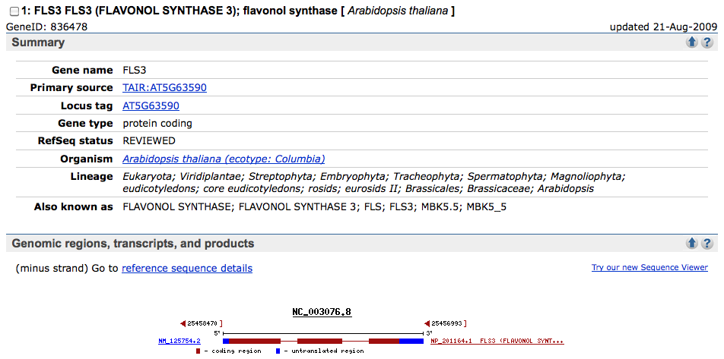
Entrez
The link “Gene” will lead us to what is like a review paper for that specific transcript. This is the result of someone (an expert) collecting the infomration in the database (curation). From this page you can get access to all the sequences associated to the gene.

Slide 34
Bioinformatics
Sequence similarity

Slide 35
Sequence comparison
Goal: To find regions of similarity in a set of sequences.

Slide 36
Sequence comparison
What for?
Transfer functional information from something well studied to something new.
Sequence assembly: transcripts or genomes.
Feature identifications, e.g., exon borders, domains.
Identify conserved regions, phylogenetics.

Slide 37
Sequence comparison: Transferring functional information
You just obtained the following sequence of your gene of interest, from a cell cycle experiment.
You do not know yet its function
>unknown_seq
TAAAATTCCCTCCTTCCCTCGTTTTCTGCTCTCTCCTTTTCTTTTCTTCTTCCTCTTTCTCTCACTAAAACCCTTGTTTC
TTCACTCGCCGTCGCTTTTCCCGTCATCGGAATCTTCAAATTCGACTCTCGCTTCACTACGATCCATGTCCGGTGTCGTA
GATCTTCTCCCGGTTCTTCTCAGCCGCCACCGCCGCCGCCGCACCATCCACCGTCATCTCCGGTTCCGGTTACATCTACG
CGGTTATACCACCTATACGTCGTCACTTAGCTTTCGCCTCAACAAAACCTCCGTTTCATCCTTCCGATGATTACCATCGA
TTAACCCTTCTTCGCTCAGTAATAATAACGACAGGAGCTTCGTTCATGGTTGTGGTGTTGTAGATCGGGAGGAAGATGCT
TCGTTGTTAGATCTCCTTCACGAAAGAGAAAGGCGACAATGGATATGGTTGTTGCTCCATCTAATAATGGATTCACGAGT
CTGGTTTCACTAACATACCTAGCAGTCCCTGTCAAACTCCTAGAAAAGGGGGCAGAGTCAACATCAAGTCAAAGGCCAAA
GAAACAAGTCAACTCCTCAAACACCCATCTCGACAAACGCTGGTTCTCCTATCACACTTACTCCATCAGGAAGTTGTCGT
ATGACAGTTCTTTAGGTCTCCTTACAAAAAAGTTCGTCAATCTAATTAAACAAGCCAAAGATGGAATGCTGGACCTAAAC
AAGCTGCAGAAACATTGGAGGTGCAGAAACGACGTATATATGATATTACAAACGTTTTGGAGGGGATAGATCTCATTGAA
AGCCTTTCAAGAATCGAATACTTTGGAAGGGAGTTGATGCGTGTCCTGGCGATGAGGATGCTGACGTATCTGTATTACAG
CAGAAATTGAAAACCTCGCCCTCGAAGAGCAAGCATTAGACAACCAAATCAGACAAACAGAGGAAAGATTAAGAGACCTG
GCGAAAATGAAAAGAATCAGAAATGGCTTTTTGTAACTGAAGAGGATATCAAGAGTTTACCAGGTTTCCAGAACCAGACT
TGATAGCCGTCAAAGCTCCTCATGGCACAACTTTGGAAGTGCCTGATCCAGATGAAGCGGCTGACCACCCACAAAGGAGA
ACAGGATCATTCTTAGAAGTACAATGGGACCTATTGACGTATACCTCGTCAGCGAATTTGAAGGGAAATTCGAAGACACA
ATGGGAGTGGTGCAGCACCACCAGCATGCTTGCCTATTGCTTCTAGCTCAGGATCTACAGGACACCATGACATCGAAGCC
TAACTGTTGACAACCCAGAAACTGCTATTGTGTCTCATGATCATCCTCATCCTCAACCCGGCGATACCTCTGATCTTAAT
ATTTGCAAGAGCAAGTAGGAGGAATGCTTAAGATTACTCCCTCTGATGTTGAAAATGATGAGTCGGACTACTGGCTTCTC
CAAATGCTGAGATTAGCATGACGGATATTTGGAAAACTGACTCTGGTATCGATTGGGATTATGGAATAGCCGACGTGAGT
CTCCACCACCAGGAATGGGCGAAATAGCACCAACAGCTGTTGACTCAACCCCGAGATGATCGAATACCAAGCACACTTCT
AACTTCTGATCCCAAATGTGTTACCTCACAACACTCCCTAAAATCATATACAAGGAGGGAGCAACTACAGAACGTGTATG
ACCAATGGCAGGTGCGTTCCATACAATGTACCATTAGATTATGATTCATTTATCGCCTAGAGTGATGTTGTAGAGGAGCA
CGAGAAACTAATGTAAGTTTAACAGAGAATGTACTTCATCGGCTGCATTGGTACACTATTTGATTATAATATTTTTGACC
CTCAAATGCATCTTTATAATCAGCTA
Your first option is to compare this sequence against a database of sequences of known functions

Slide 38
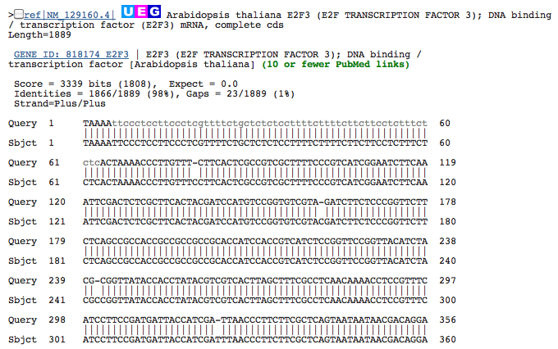
Sequence comparison: Transferring functional information
For more info check: http://www.ncbi.nlm.nih.gov/pmc/articles/PMC3820096/

Slide 39
Sequence comparison
What for?
Transfer functional information from something well studied to something new.
Sequence assembly: transcripts or genomes.
Feature identifications, e.g., exon borders, domains.
Identify conserved regions, phylogenetics.

Slide 40
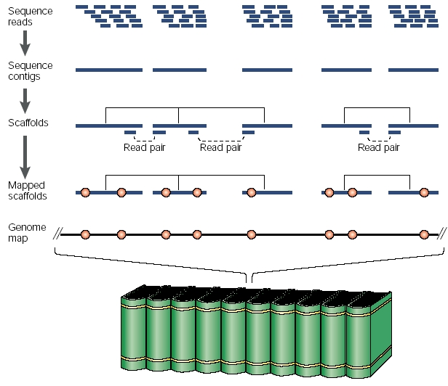
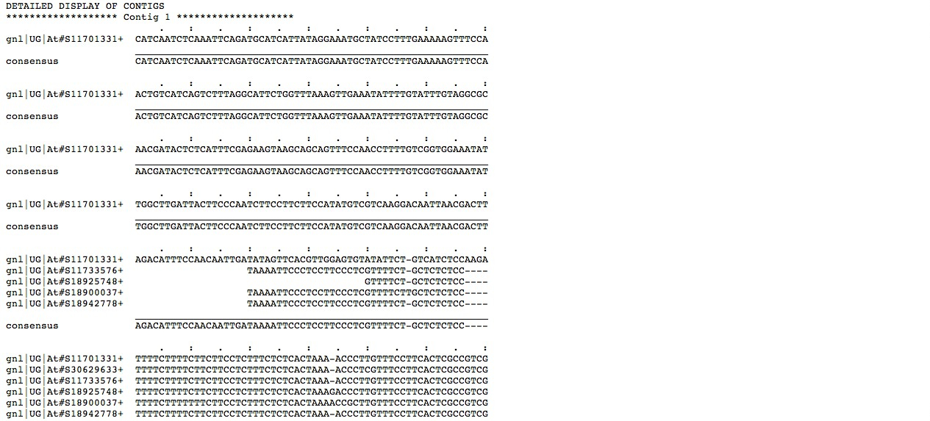
Sequence comparison: Genome and transcript assembly
Building unigene sets from EST sequences
http://www.nature.com/scitable/topicpage/complex-genomes-shotgun-sequencing-609

Slide 41
Sequence comparison
What for?
Transfer functional information from something well studied to something new.
Sequence assembly: transcripts or genomes.
Feature identifications, e.g., exon borders, domains.
Identify conserved regions, phylogenetics.

Slide 42
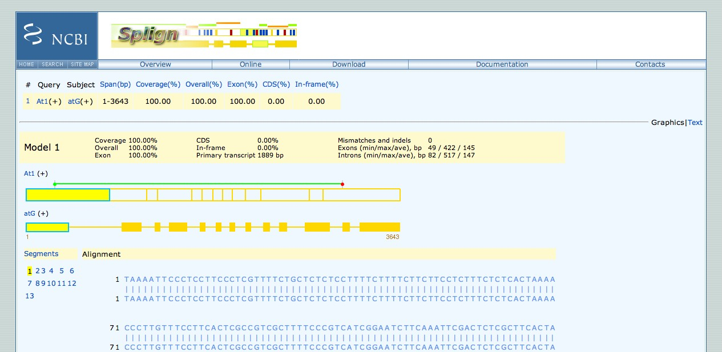
Sequence comparison: Identify features: exon-intron borders
http://www.ncbi.nlm.nih.gov/sutils/splign/splign.cgi

Slide 43
Sequence comparison
What for?
Transfer functional information from something well studied to something new.
Sequence assembly: transcripts or genomes.
Feature identifications, e.g., exon borders, domains.
Identify conserved regions, phylogenetics.

Slide 44
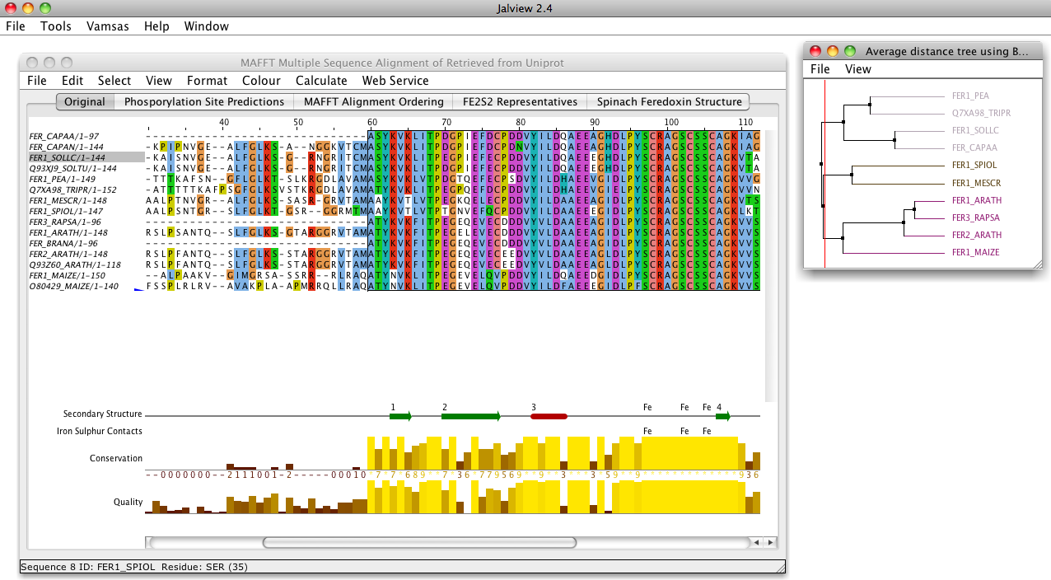
Sequence comparison: Identify conserved regions

Slide 45
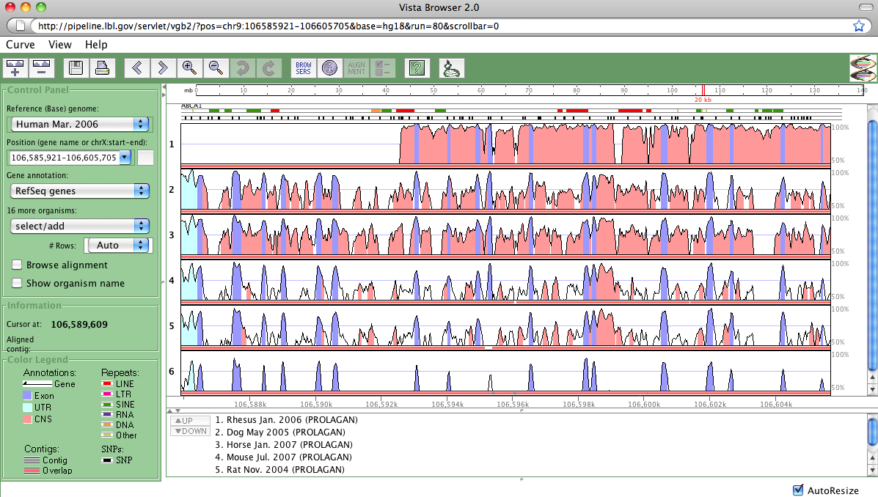
Sequence comparison: Identify conserved regions

Slide 46
About similarity and homology
Similarity | This is a measure that tells you the degree of match between corresponding positions in a sequence. Usually it is expressed a percent identity or percent conservation.
Identity | This measure expressed the proportion of positions that do not change between two sequences.
Homology | This is not a measure but a statement about the relationship between sequences. Two sequences are homologous if and only if they are related by divergent evolution from a common ancestor.
‘Protein X is 43% is homologous to protein Y’ WRONG!
You could say that the two sequences are 43% identical or 43% similar.
Percent homology does not exists.
You can't be partially homologous: that would be like being partially dead, or partially pregnant. You're either homologous or you're not.
Petsko 2001, Genome Biology 2(2)

Slide 47
About similarity and homology
Similarity can suggest homology. Homologues traits/sequences might (or might not) have the same function.
If two sequences are similar along their full length, in most cases they are homologues.
>40% identity strongly suggest homology.
Low complexity regions (repeats), can be highly similar without being homologues.
Homologous sequences are not always similar.

Slide 48
Types of Homology: Orthologous and Paralogous genes
Orthologous genes: The most recent evolutionary event by which two genes are related to each other is a speciation event.
Co-orthologues or in-paralogues: When a genomic duplication event follows the speciation event.
Paralogous genes: The most recent evolutionary event by which two genes are related to each other is a gene duplication event.
Xenologous genes: Genes that originate from a horizontal transfer event.
We need to know both the evolutionary history of the species and of the genes to identify such types of homology

Slide 49
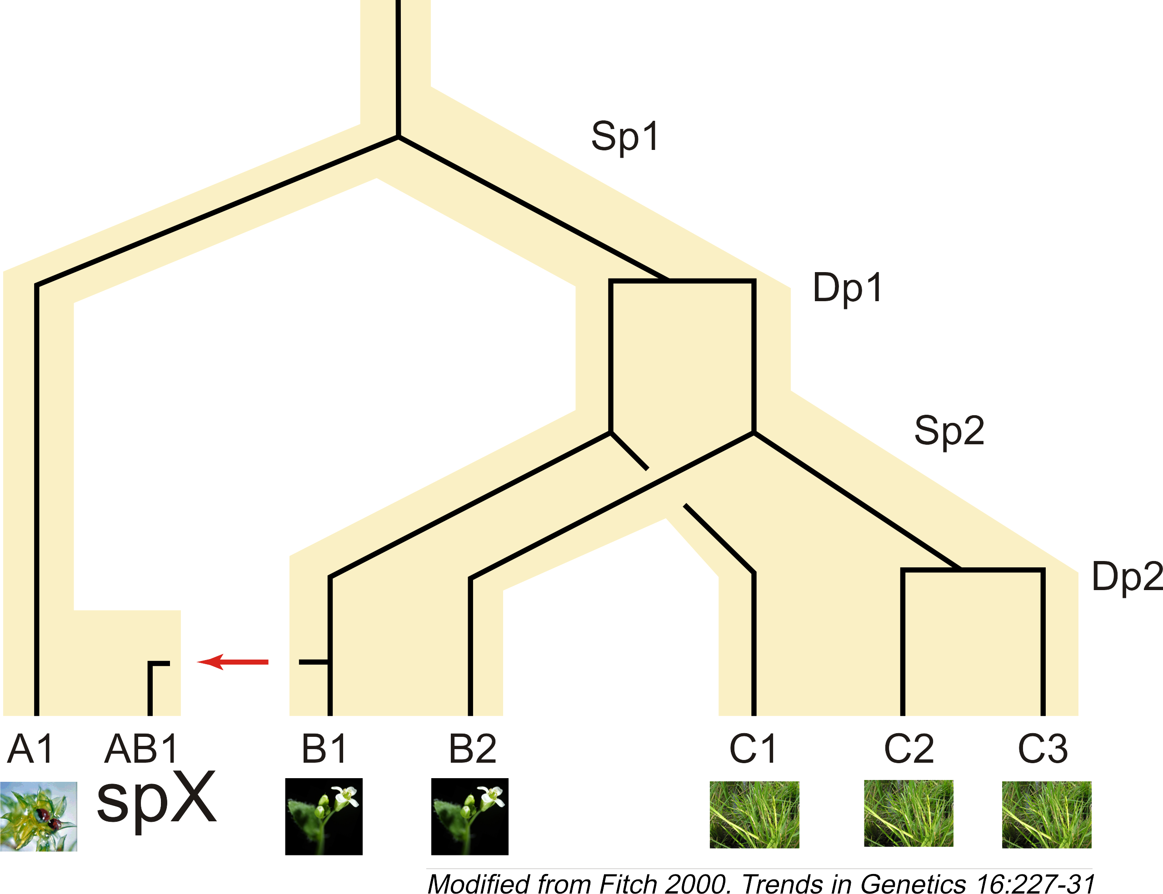
Types of Homology: Orthologous and Paralogous genes
Fitch, W. M. Homology a personal view on some of the problems. Trends Genet, 2000, 16, 227-231
Moss
Arabidopsis
Rice

Slide 50
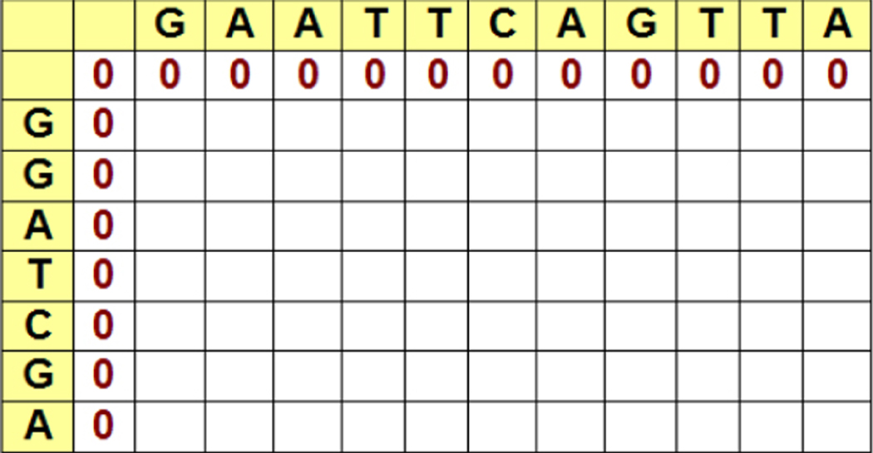
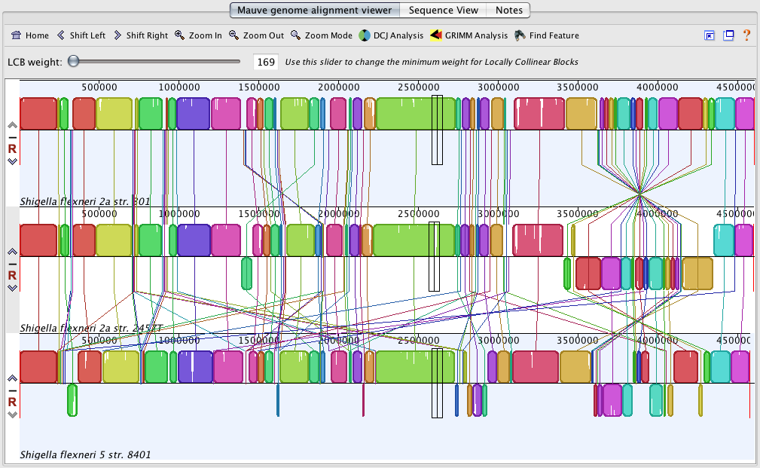
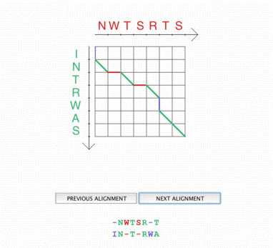
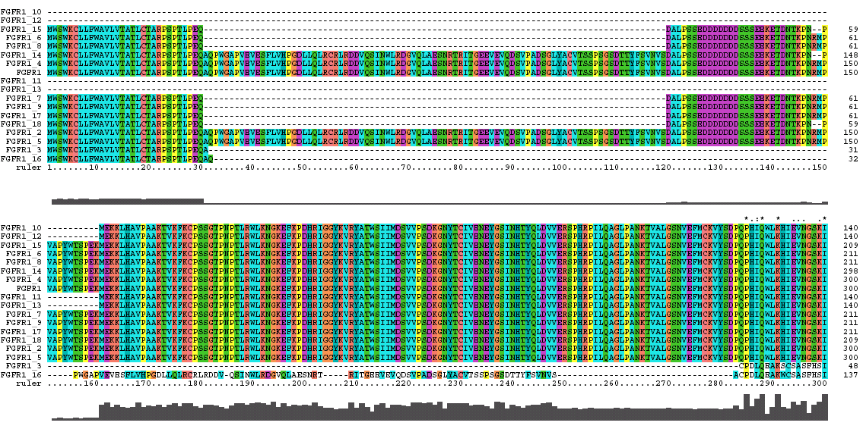
Sequence Alignment
Goal: to identify similar regions or positions in a set of sequences.

Slide 51
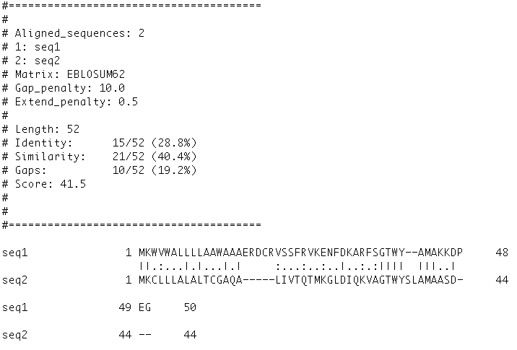
Assessing similarity

Slide 52
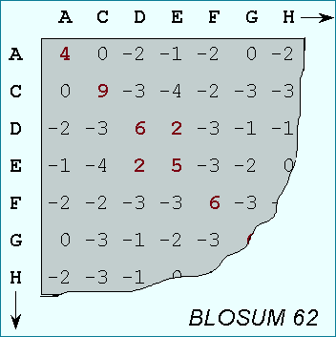
Alignment parameters
Alignments are not independent/absolute trues
They depend on the the following parameters, and you must keep in mind that an alignment is the best solution (best score) given a set of parameters. Changes in the parameters change the results
Open gap penalty
Extension gap penalty
Model insertion/deletions
Scoring/substitution matrix
Model relatedness through evolutionary time

Slide 53
Assessing similarity

Slide 54
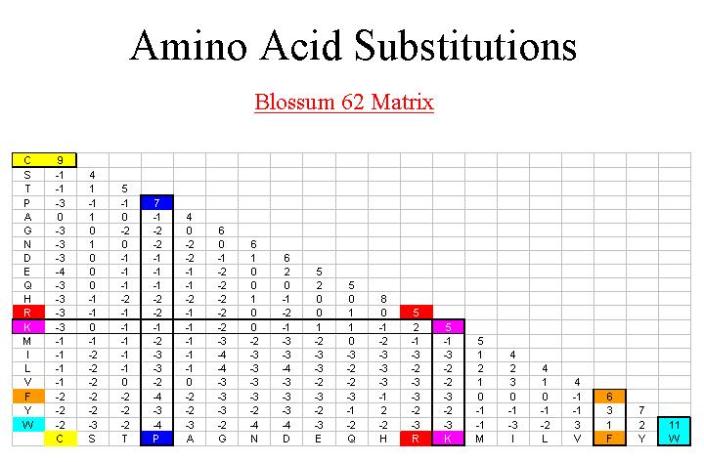
Substitution matrices
For more info check: Eddy SR. 2004. Where did the BLOSUM62 alignment score matrix come from? Nature Biotechnology 22:1035-1036
How similar is Alanine to Glycine?
http://courses.washington.edu/bioinfo/Pabio536/Spring-Current/Weekly%20notes%20and%20resources.htm

Slide 55
Substitution matrices
Many substitutions matrices. How to choose?
BLOSUM 80
PAM 1
BLOSUM 62
PAM 120
BLOSUM 45
PAM 250
Less divergent
More divergent

Slide 56
Sequence Alignment– Dot Plot
Exploratory analysis
Comparing two sequences with lengths M and N, create a grid with dimensions M * N. Put one of the sequences in the horizontal direction and the other in the vertical direction
Given the sequence:
CGCTACG
CGATACGT
 | C | G | C | T | A | C | G
C
G
A
T
A
C
G
T

Slide 57
Sequence Alignment– Dot Plot
For each position compare the element of rows and columns, if they are the same color the cell.
 | C | G | C | T | A | C | G
C
G
A
T
A
C
G
T
Regions of similarity appear as diagonals in the grid

Slide 58
Sequence Alignment– Dot Plot
Dotlet – Swiss Institute of Bioinformatics
https://dotlet.vital-it.ch/
Try the examples in:
http://myhits.isb-sib.ch/util/dotlet/doc/dotlet_examples.html

Slide 59
Alignment Tools: EMBOSS
The European Molecular Biology Open Software Suite
It is a suite of programs and with open source code developed to supply the needs from the molecular biology community.
Can be installed in any computer with the Linux Operative System.
There are some web interfaces, such as Jemboss, wEMBOSS and Mobyle. For instance you can try: http://mobyle.pasteur.fr/cgi-bin/portal.py
Notes:
Si hay errores en los algoritmos cualquiera se pueda dar cuenta, y los puede corregir.

Slide 60
Two main types of exact pairwise sequence alignment
Global
Needleman SB, Wunsch CD. 1970. A general method applicable to the search for similarities in the amino acid sequence of two proteins. J Mol Biol. 48(3):443-53.
Eddy SR. 2004. What is dynamic programming? Nat Biotechnol. 22(7):909-10.

Slide 61
Two main types of exact pairwise sequence alignment
Local
Smith TF, Waterman MS. 1981. Identification of common molecular subsequences. J Mol Biol. 147(1):195-7.
Make the alignment with the sequences: http://myhits.isb-sib.ch/util/dotlet/doc/consdomain.html using the tools water (local alignment) and needle (global alignment), using https://usegalaxy.org/

Slide 62
BLAST: Basic Local Alignment Search Tool

Slide 63
BLAST Basic Local Alignment Search Tool
The pairwise sequence alignment algorithms Smith & Waterman (local) y Needleman & Wunsch (global) provide exact solutions, i.e., always get the optimal solution for a given set of parameters, but they are very costly (memory and time).
To overcome this, BLAST was developed as an heuristic algorithm, this means that it is not guaranteed that it will find the optimal solution, but instead will get an approximate solution very fast. To achieve this it takes shortcuts.

Slide 64
BLAST Basic Local Alignment Search Tool
Search for regions of local similarity between pairs of sequences, it is very fast and useful when used for searches in large sequence databases
It is a preliminary search engine.
Remember: Only local alignment searches!

Slide 65
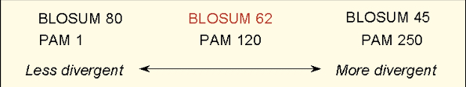
BLAST Basic Local Alignment Search Tool
The same way as for the pairwise exact alignment algorithms, BLAST depends of :
Gaps
Open gap penalty
Extension gap penalty
DMRP

Slide 66
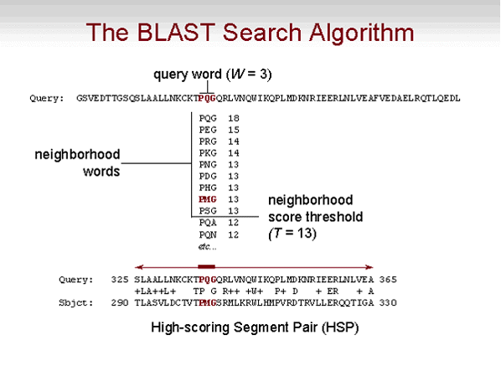
BLAST Basic Local Alignment Search Tool
BLAST misses hard to find matches
Altschul et al., 1990. Basic Local Alignment Search Tool. J. Mol. Biol. (1990) 215, 403–410
http://www.ncbi.nlm.nih.gov/Education/BLASTinfo/BLAST_algorithm.html

Slide 67
This alignment cannot be found using BLAST with W=11
1 GAATATATGAAGACCAAGATTGCAGTCCTGCTGGCCTGAACCACGCTATTCTTGCTGTTG
|||| ||||| |||| |||||| ||||||| |||||| |||||| |||||||| |||||
1 GAATGTATGATGACCCAGATTGTAGTCCTGAAGGCCTGGACCACGGTATTCTTGTTGTTG
61 GTTACGGAACCGAGAATGGGAAAGACTACTGGATCATTAAGAACTCCTGGGGAGCCAGTT
| |||||||| |||||||||| |||||||| |||| |||||| |||||||| |
61 GCTACGGAACTAAGAATGGGAAGAACTACTGGCTCATCAAGAACAGCTGGGGAGAATCCT
121 GGGGTGAACAAGGTTATTTCAGGCTTGCTCGTGATAAAAAC
|||| || ||||| || |||||||| ||||||| ||||||
121 GGGGAGACCAAGGCTACATCAGGCTTTCTCGTGACAAAAAC
Why?

Slide 68
BLAST Basic Local Alignment Search Tool
Significance
What is a good alignment?
What would you expect by chance alone?
Can you get the same, or better, alignment score by chance?
For this we compute the “Expect-value”.
The Expect value is the number of alignments with a scores equal or better than the observed score, that we expect to occur in a database search by chance.
Smaller E-values are more significant
The computation of the E-value depends of the scoring matrix and the gap penalties used during the alignment, as well as the size of the target database.
DMRP

Slide 69
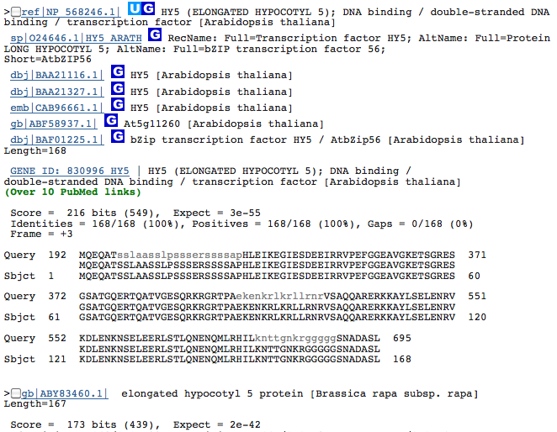
BLAST Basic Local Alignment Search Tool
Example Results
DMRP

Slide 70
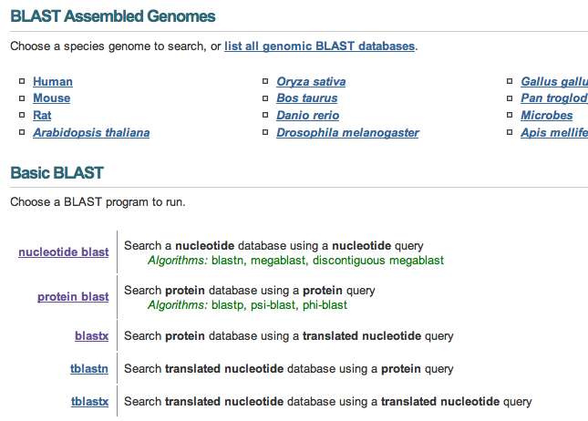
BLAST
http://blast.ncbi.nlm.nih.gov/

Slide 71
Example
From https://github.com/labbces/smagro2019, get the file desconocido.fa
Follow the instructions in the file blast.practical.txt, available in the same repository.

Slide 72
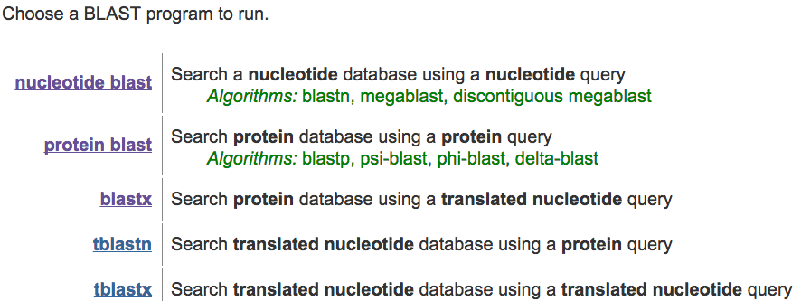
Main BLAST flavors

Slide 73
Keep in mind
When there are stretches of the same residue
When BLAST do not return any result
You are getting to high E-values
You are getrting too much matches
Use the low complexity filter
You can change the scoring matrix, or the gap penalties. Or try another BLAST program and/or database, .e.g, blastx instead of blastn
Change search parameters, matrix, gaps penalties, to confirm the robustness of your match.
Change target database, or filter your results based on e.g., taxonomy

Slide 74
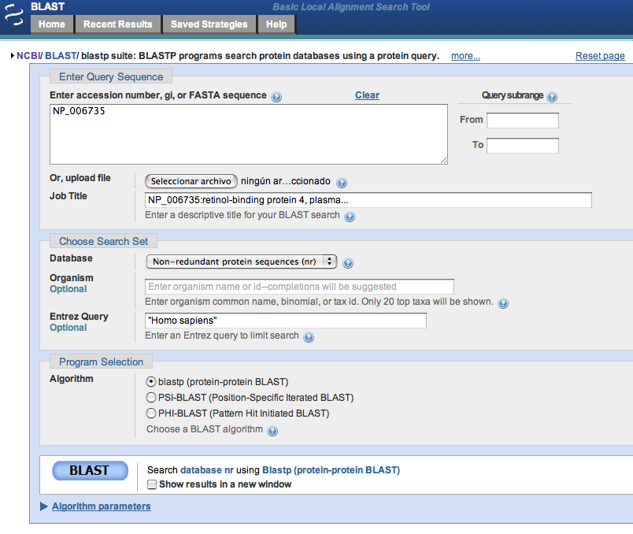

Slide 77
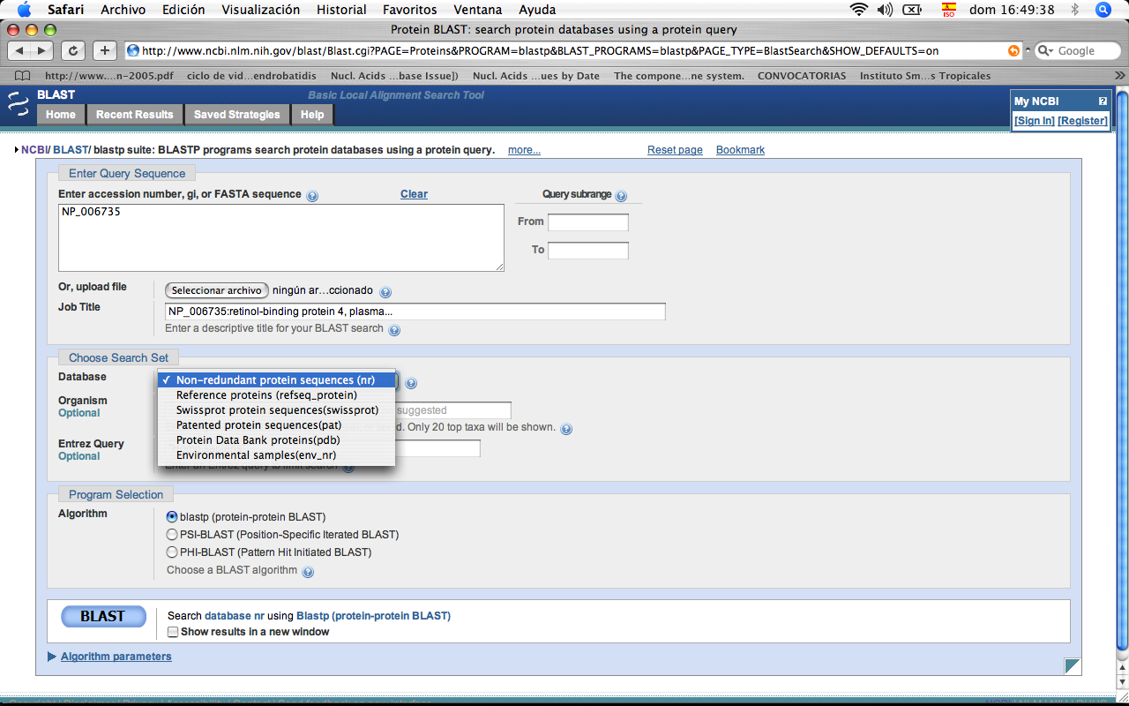

Slide 78
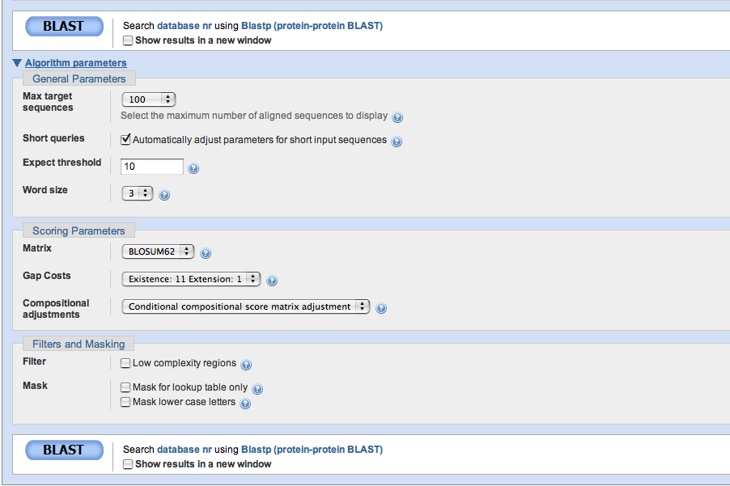
Number of alingments with a score equal or better than the obeserved score fron a search agains a random database.
Notes:
Expect
This setting specifies the statistical significance threshold for reporting matches against database sequences. The default value (10) means that 10 such matches are expected to be found merely by chance, according to the stochastic model of Karlin and Altschul (1990). If the statistical significance ascribed to a match is greater than the EXPECT threshold, the match will not be reported. Lower EXPECT thresholds are more stringent, leading to fewer chance matches being reported.

Slide 79
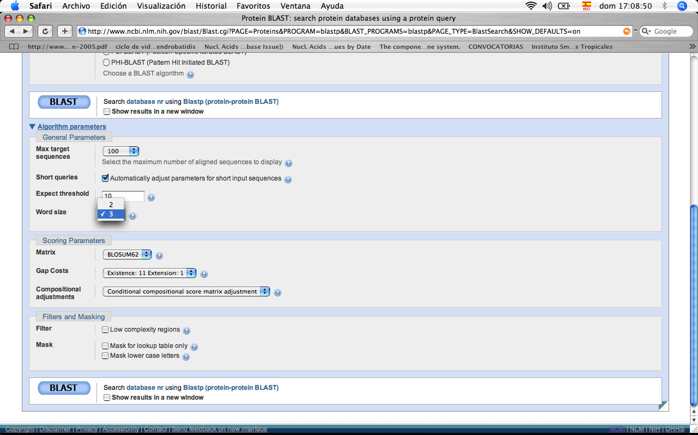
Word size to start search. With larger word size leads more similar matches and faster searches

Slide 80
WORD SIZE
 |  | WORD SIZE
BLAST N | Highly similar sequences (megablast ) | 16,18,20,24
 |  | 28,32,48,64
 | More dissimilar sequences (discontiguous megablast) | 11,12
 | Somewhat similar sequences (BLASTn) | 7,11,15
BLAST P | BLASTp (protein-protein BLAST) | 2,3
 | PSI-BLAST (Position-Specific Iterated BLAST) | 2,3
 | PHI-BLAST (Pattern Hit Initiated BLAST) | 2,3

Slide 81
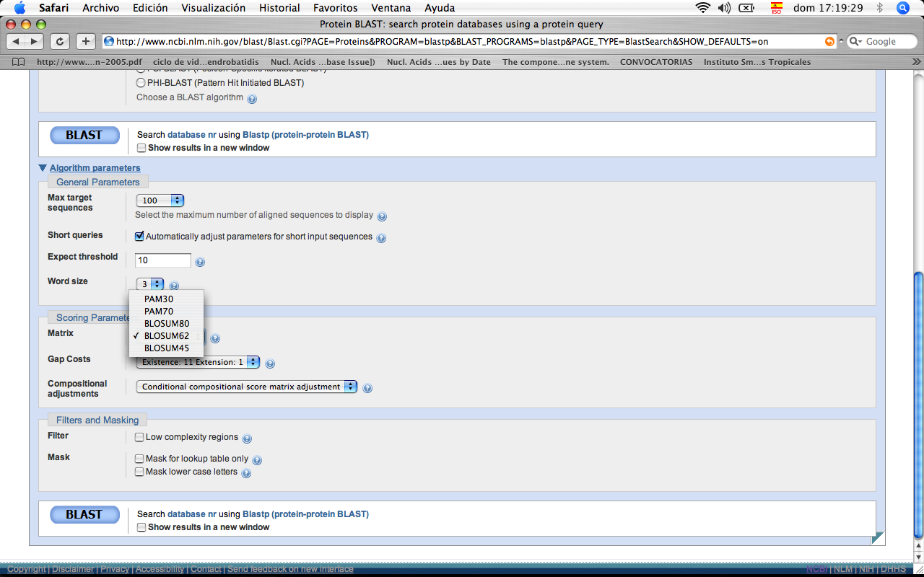
Scoring matrix. Try several in your searches when you are not sure about which one to use.

Slide 82
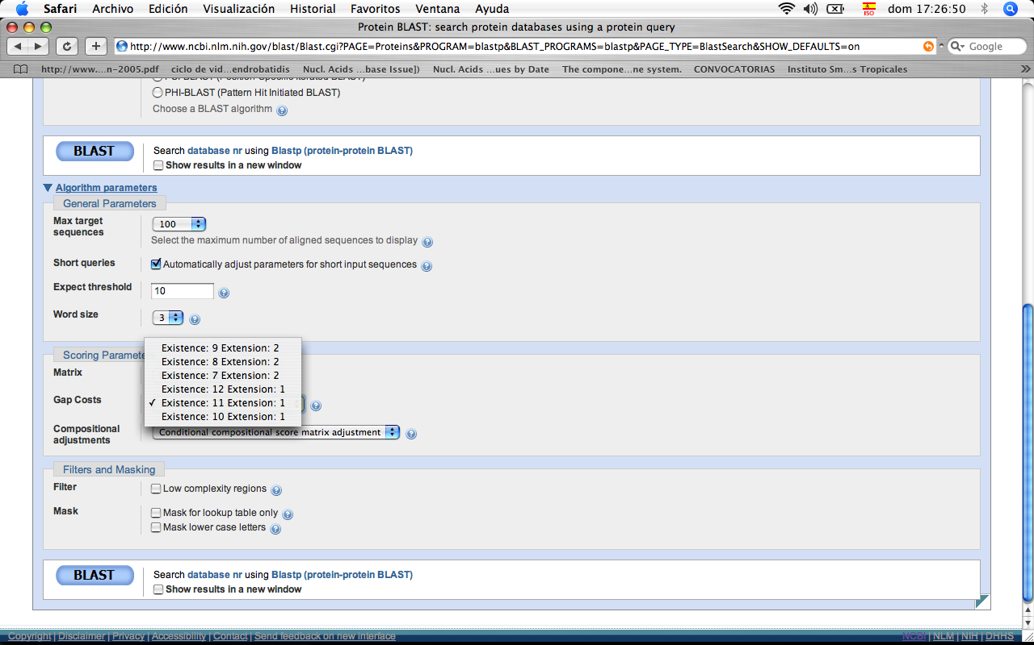

Slide 83
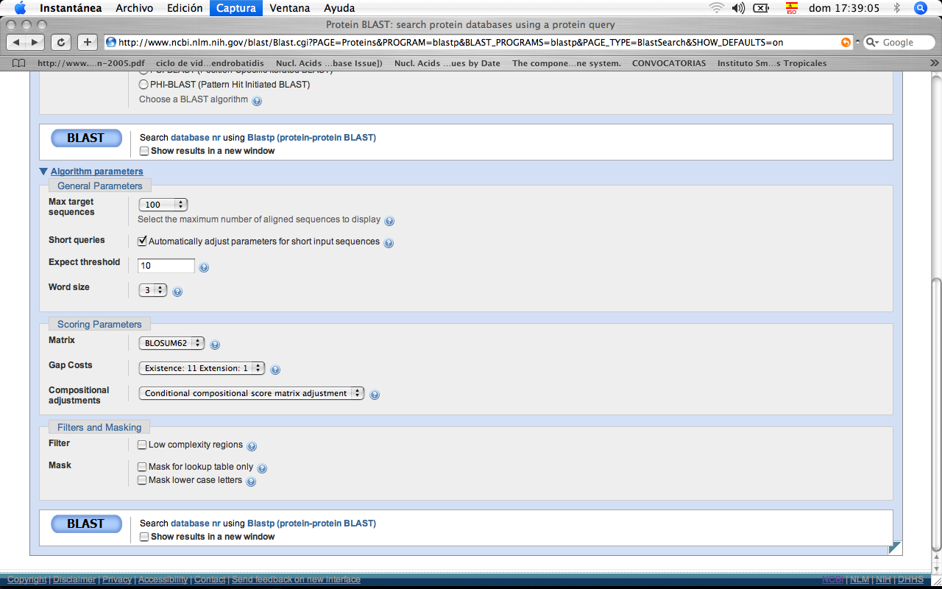

Slide 84
BLAST filters: Low complexity regions
These regions can give rise to artificially good e-values (low), i.e., the two sequences being comapred are actually not related
e.g.: PPCDPPPPPKDKKKKDDGPP
In some case you migth actually be interested in these regions, particularly in proteins. If that is the case use further toold to for instance look for domains or repeated sequences. Alternatively you can try the BLAST with and without activating the filter
DMRP

Slide 85
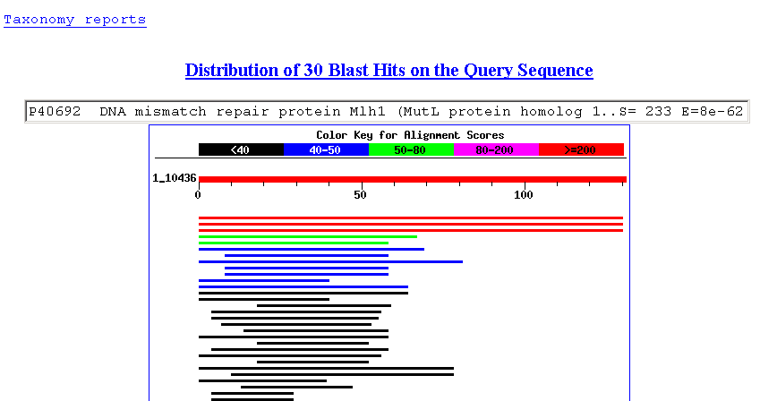
BLAST Output
Orden por taxonomía
mouse

Slide 86
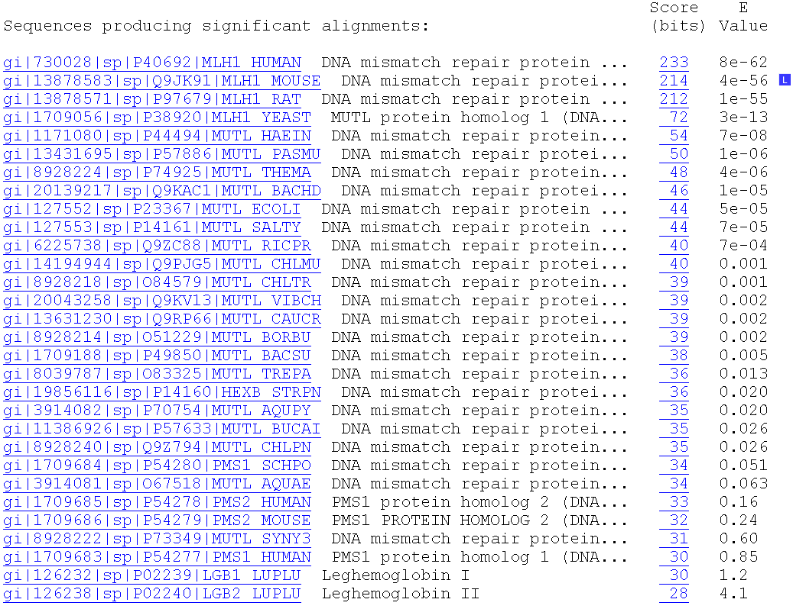
BLAST Output
Sort by E-value
4 X 10⁻⁵⁶
Link to entrez
LocusLink
Default e value cutoff 10
Bacterial mismatch repair proteins

Slide 87
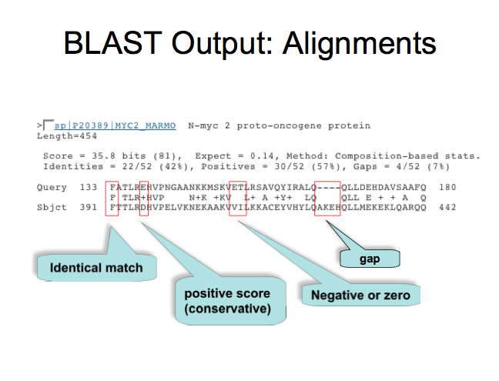
Salida de BLAST: alineamientos

Slide 88
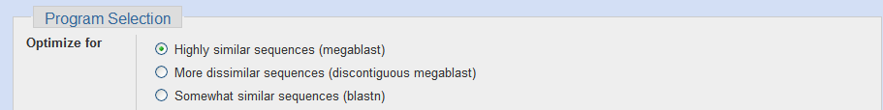
Program Selection BLASTn

Slide 89
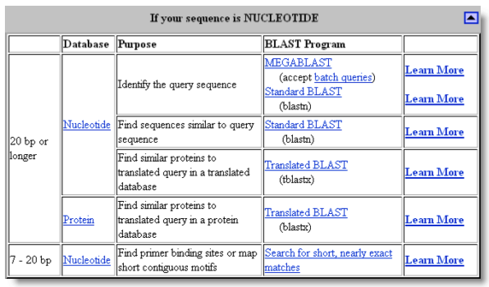

Slide 90
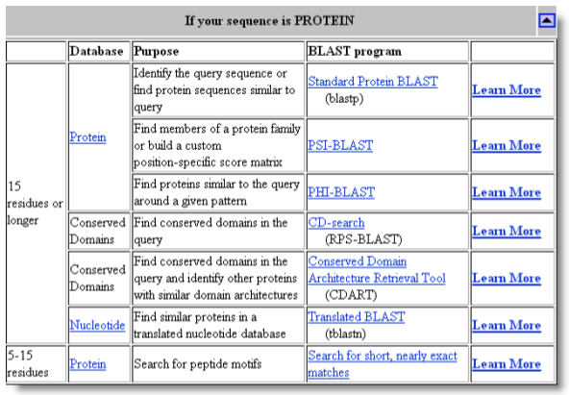

Slide 91
END
Part I

